Slide 1
Machine Learning-Based Caloric Expenditure Prediction for Personalized Fitness Assessment during Physical Activity
SUDHARSAN S - 210701266
SWETHA ADLURU - 210701276

Slide 2
ABSTRACT
This project aims to utilize machine learning to understand how our bodies burn calories during various activities. Data collected includes age, gender, height, weight, exercise duration, heart rate, and temperature. After preprocessing, multiple machine learning models like Linear Regression and Decision Trees are trained. Evaluation metrics like Mean Squared Error and R2 Score show that the Random Forest Regressor performs best in predicting calorie expenditure accurately. To make this accessible, a user-friendly app is created where users input their data such as age, gender, height, weight, exercise duration, heart rate, and temperature, and the app predicts calories burnt.
9

Slide 3
INTRODUCTION
This project delves into the realm of machine learning to predict caloric expenditure during physical activities accurately. By collecting and analyzing data encompassing variables such as age, gender, weight, exercise duration, heart rate, and temperature, we aimed to enhanace personalized fitness assessments. After training multiple machine learning models like Linear Regression and Decision Trees and evaluating them using metrics like Mean Squared Error and R2 Score, the Random Forest Regressor stood out as the most precise in predicting calorie burn. This research endeavor seeks to revolutionize personalized health evaluations, paving the way for informed decision-making and improved fitness outcomes.
9

Slide 4
EXISTING SYSTEM
The existing systems for estimating calorie expenditure during workouts rely on traditional methods and manual calculations using preset equations or algorithms. However, these approaches lack depth and accuracy as they do not consider individual body types and activity levels. This leads to generic estimates that may not accurately reflect a person's actual calorie burn, impacting fitness planning and strategies. Furthermore, current system interfaces are basic, lacking real-time feedback or interactive features, limiting their adaptability to user needs. They struggle to adjust calculations for varying exercise intensities, durations, and environments, resulting in inconsistent predictions and less effective fitness planning. Therefore, there's a clear need for more advanced methods like machine learning algorithms to enhance predictions, personalized health assessments, and fitness optimization strategies. With an accuracy level of 68.53%, these methods can significantly improve the accuracy and effectiveness of calorie expenditure estimation during workouts.
9

Slide 5
PROPOSED SYSTEM
The new exercise calorie burning predictor system utilizes advanced machine learning methods for accurate and personalized fitness assessment. It collects various data points such as age, gender, height, weight, exercise duration, heart rate, and temperature to create a comprehensive dataset. This data is then preprocessed, converting categorical variables into numerical formats for machine learning analysis. The model, focused on the random forest regressor approach, is trained and tested using this dataset to predict calorie burn accurately. To make this technology accessible, a user-friendly application is developed using the Streamlit framework. Users input their details like age, gender, workout duration, heart rate, and exercise temperature. The app uses the trained model to estimate the calories burnt during the exercise, democratizing personalized fitness assessment.
9

Slide 6
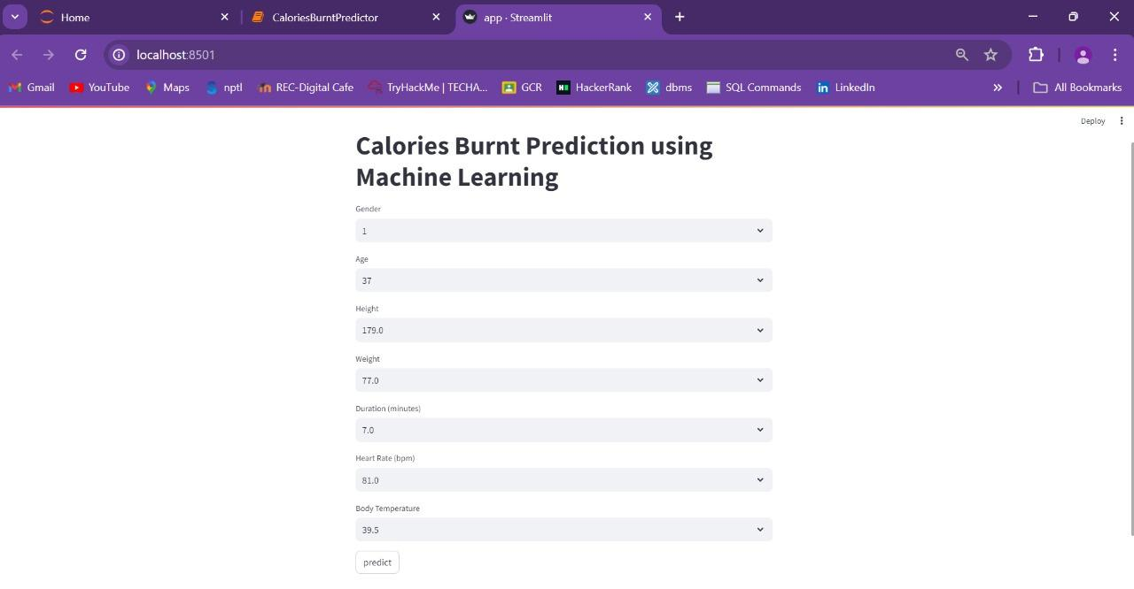
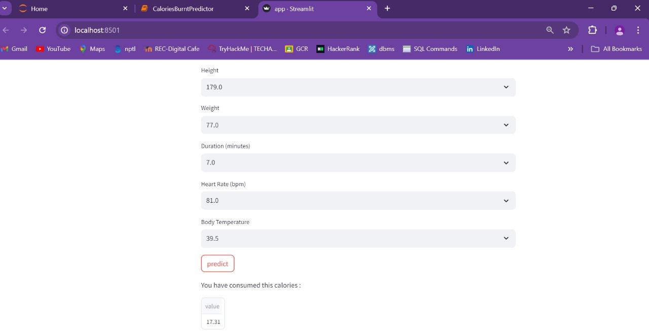
IMPLEMENTATION PROTOTYPE
9

Slide 7
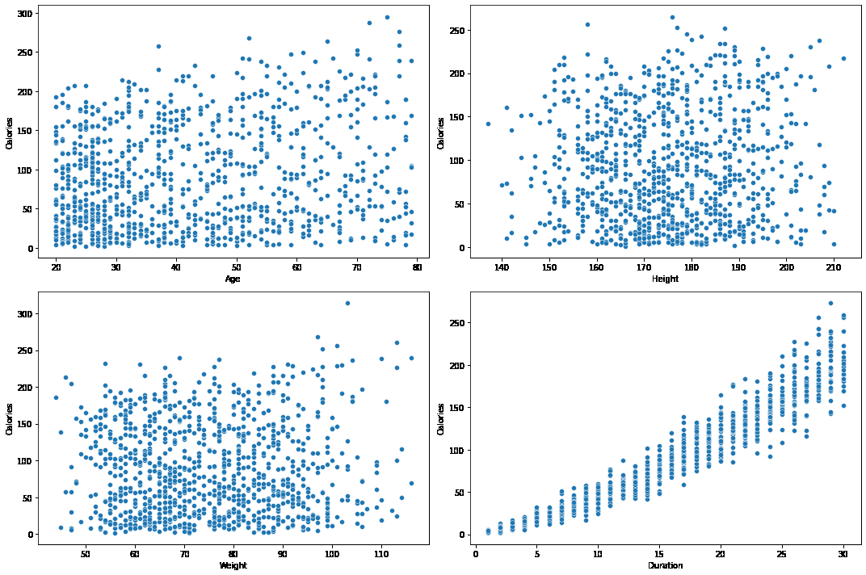
COMPARATIVE ANALYSIS
9

Slide 8
CONCLUSION
In conclusion, our new exercise calorie burning predictor system offers a significant advancement in personalized fitness assessment. By leveraging machine learning techniques, especially the random forest regressor approach, we achieve accurate predictions of calorie burn during exercise. The inclusion of various data points and thorough preprocessing ensures the model's reliability and effectiveness. The development of a user-friendly application further enhances accessibility, allowing individuals to estimate their calorie expenditure with ease. This technology has the potential to revolutionize fitness planning by providing tailored insights and optimizing health strategies based on individual characteristics and activity levels. Overall, our project showcases the transformative impact of machine learning in improving health and fitness assessment, paving the way for smarter decision-making and better outcomes in physical activity planning.
9

Slide 9
FUTURE ENHANCEMENT
Future improvements to the "Calories Burnt Predictor" project could include integrating additional features such as food and nutrition data to improve prediction accuracy Increase the energy that the model can generate if expanded dataset to include people for different number groups and different exercises. Using user feedback to refine predictions over time and incorporating advanced machine learning algorithms such as deep learning can further enhance performance Furthermore, to be a mobile app that offers greater accessibility and real-time tracking, can dramatically enhance user experience and engagement.
9

Slide 10
REFERENCE
1. Aziz, Mohammad Tarek, et al. "Calories Burnt Prediction Using Machine Learning Approach." Rangamati Science and Technology University, Bangladesh, October 2023. Available at: (PDF) Calories Burnt Prediction Using Machine Learning Approach
2. Panwar, Punita, et al. "A Study on Calories Burnt Prediction Using Machine Learning." Jaipur Engineering College & Research Centre, Computer Science Department, Jaipur, Rajasthan, India, July 2023. Available at: (PDF) A Study on Calories Burnt Prediction Using Machine Learning
3. Kadam, A. "Calories Burned Prediction Using Machine Learning." IEEE Xplore, 2023. Available at: Calories Burned Prediction Using Machine Learning | IEEE Conference Publication
9

Slide 11
REFERENCE
4. Meenigea, Niharikareddy. "Calorie Burn Prediction: A Machine Learning Approach using Physiological and Environmental Factors." JETIR, 2014. Available at: Calorie Burn Prediction: A Machine Learning Approach using Physiological and Environmental Factors
5. A Study on Calories Burnt Prediction Using Machine Learning." ITM Web of Conferences 54, 01010 (2023) I3CS-2023. Available at: A Study on Calories Burnt Prediction Using Machine Learning | ITM Web of Conferences
6. Nipas, Marte, et al. "Burned Calories Prediction using Supervised Machine Learning: Regression Algorithm." 2019 18th IEEE International Conference On Machine Learning And Applications (ICMLA).
9

Slide 12
REFERENCE
7. Wesly, U. John, et al. "Calorie and Body Mass Index Prediction Using Machine Learning." International Journal of Research Publication and Reviews, Vol 4, no 4, pp 1154-1158, April 2023. Available at: Calorie and Body Mass Index Prediction Using Machine Learning
8. Ratnakar, Suvarna Shreyas, and Vidya S. "Calorie Burn Prediction using Machine Learning." International Advanced Research Journal in Science, Engineering and Technology, Vol. 9, Issue 6, June 2022. Available at: Calorie Burn Prediction using Machine Learning
9

Slide 13
Thank you
for listening!

